Slide 1

T
CUAI Research MM 1팀
2025.11.25
발표자 : 신승현

Slide 2
팀원 소개
스터디원 1 : 김현수
스터디원 2 : 나상현
스터디원 3 : 신승현
스터디원 4: 오규안

Slide 3
Research Plan
일시, 방식) 매주 월요일 15-17시 대면 미팅
목표) JMLR submission
연구 주제)
3D Visual Grounding with LVLM

Slide 4
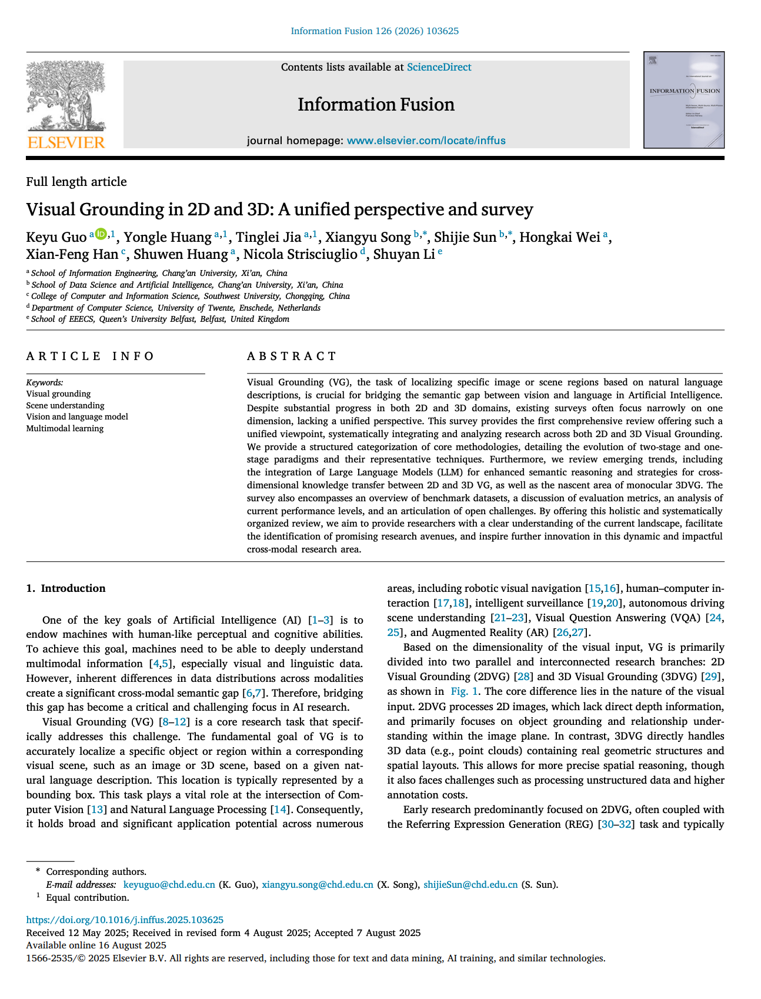
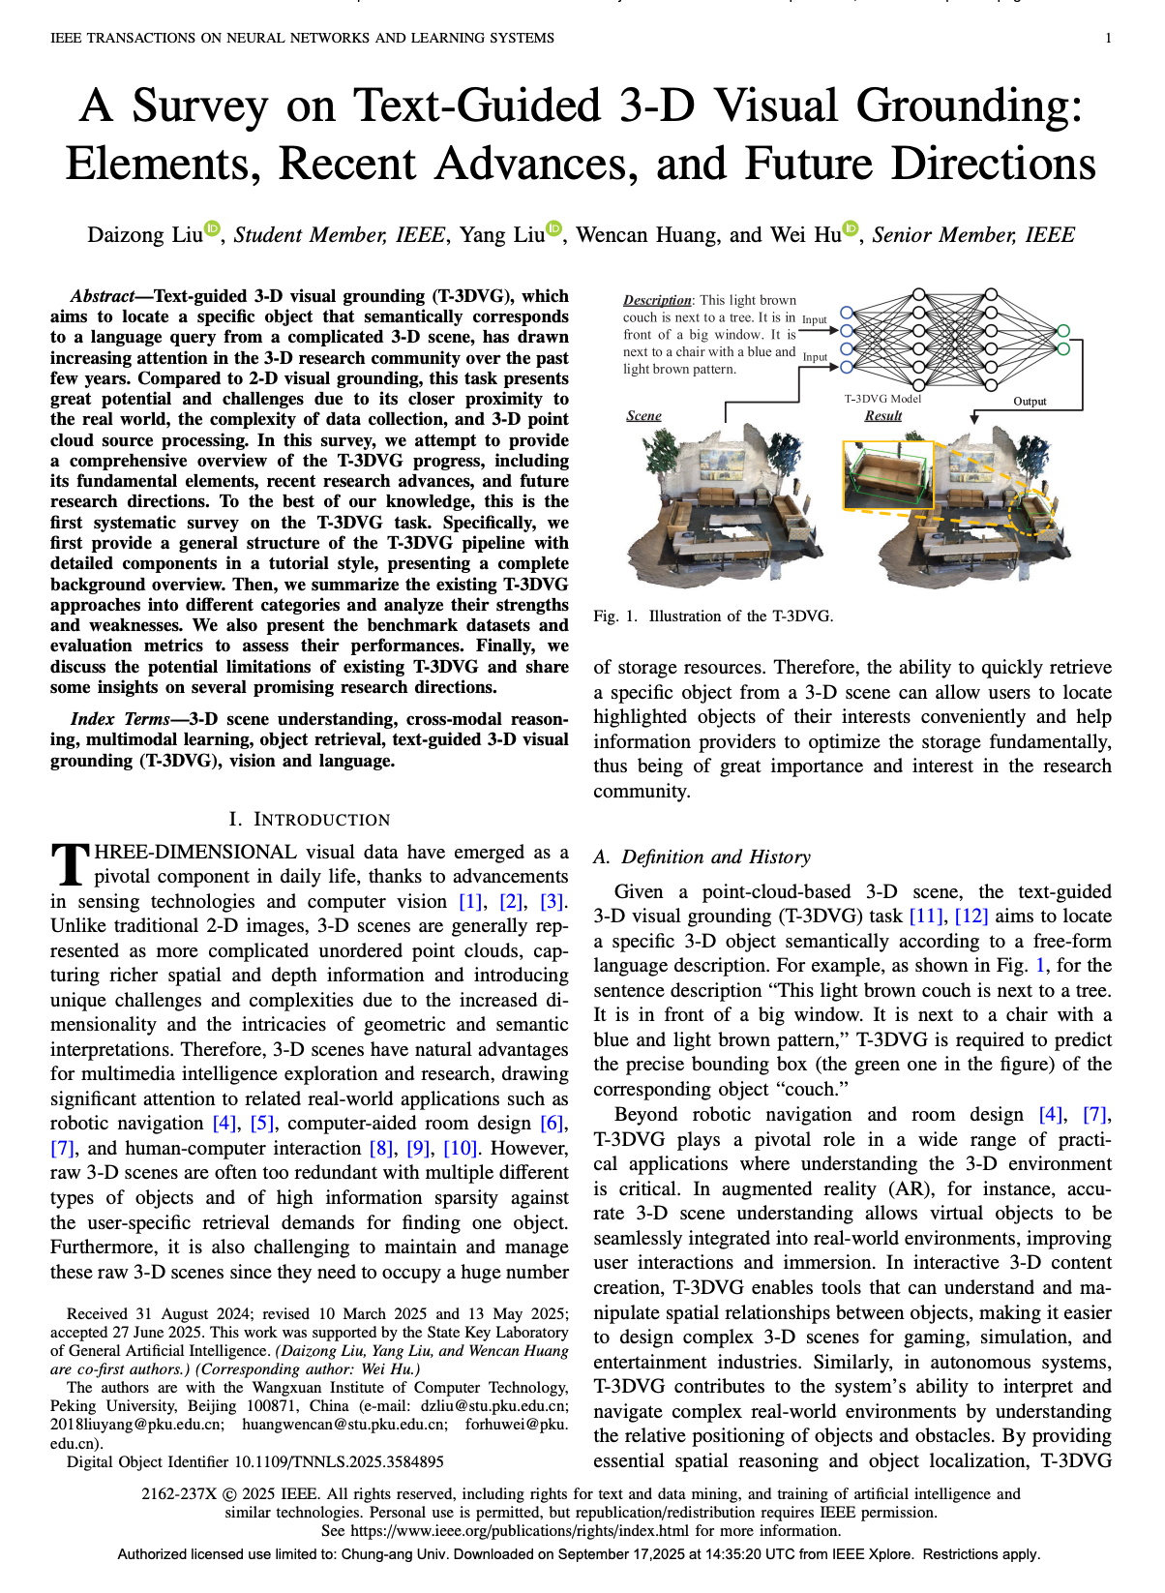
Research Plan: 3D Visual Grounding Survey 읽고 연구 주제 논의

Slide 5
Research Plan: Key Limitation of 3D Visual Grounding
- Strong reliance on full supervision Heavy dependence on large-scale, manually annotated datasets.
- Foreground–background ambiguity & spatial reasoning Difficulty in distinguishing targets from clutter and reasoning about complex spatial relations.
- Lack of robustness in real-world settings Struggles with uncertain situation(multi-object, no-object, …)
- Feature space discrepancy Misalignment between visual and linguistic feature representations.
- Insufficient local reasoning Limited ability to capture fine-grained details and object-level semantics.

Slide 6
Research Plan: Key Limitation of 3D Visual Grounding
- Strong reliance on full supervision Heavy dependence on large-scale, manually annotated datasets.
- Foreground–background ambiguity & spatial reasoning Difficulty in distinguishing targets from clutter and reasoning about complex spatial relations.
- Lack of robustness in real-world settings Struggles with uncertain situation(multi-object, no-object, …)
- Feature space discrepancy Misalignment between visual and linguistic feature representations.
- Insufficient local reasoning Limited ability to capture fine-grained details and object-level semantics.

Slide 7
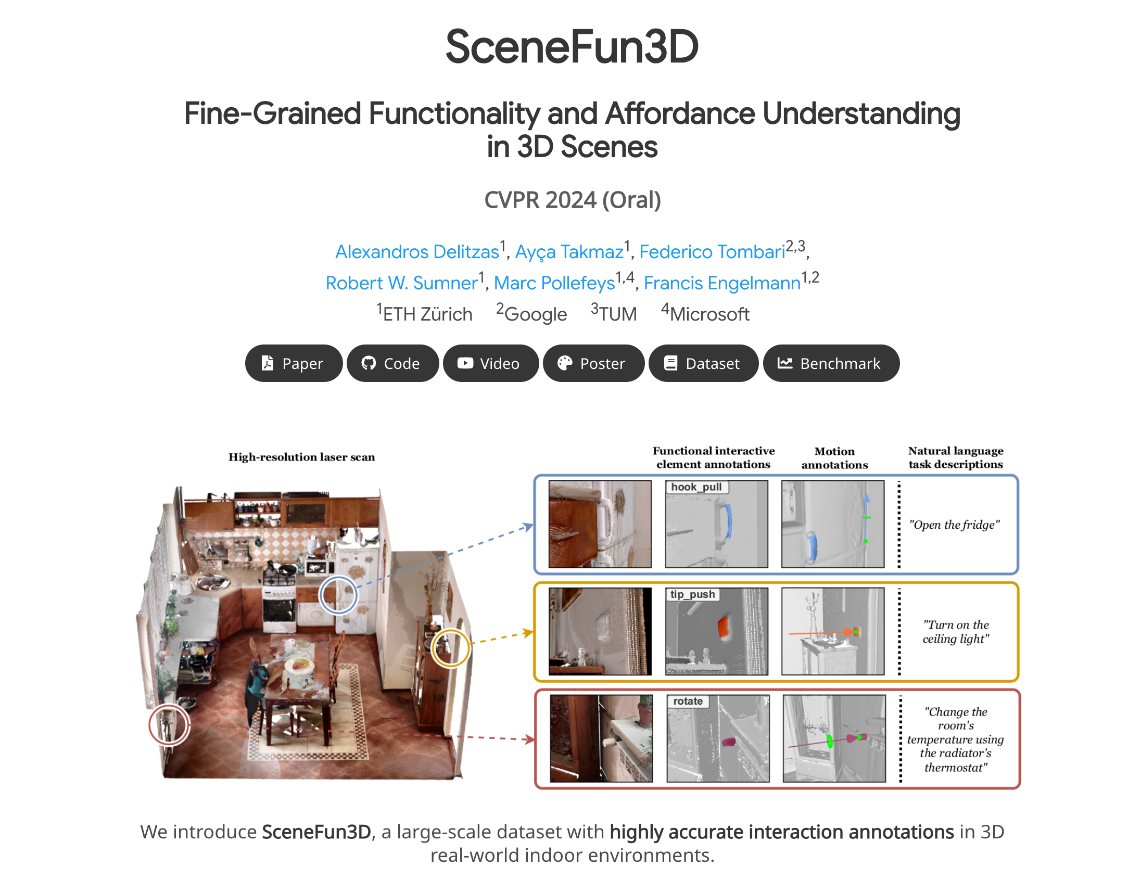
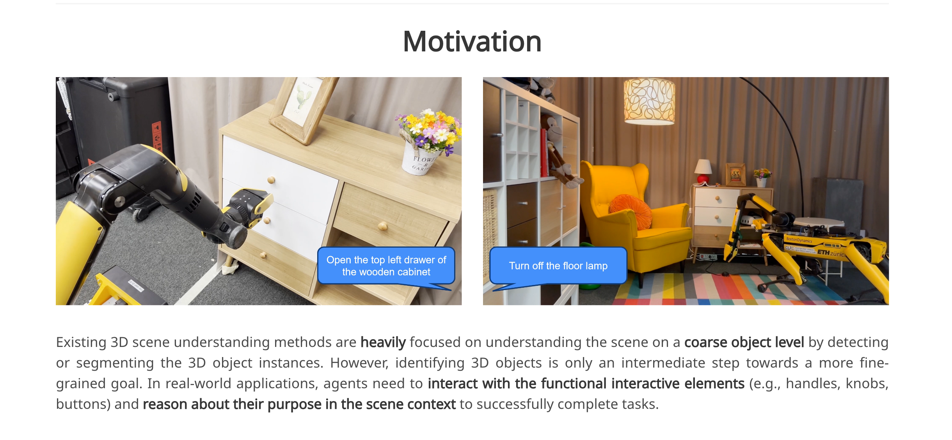
Research Plan: SceneFun3d

Slide 8
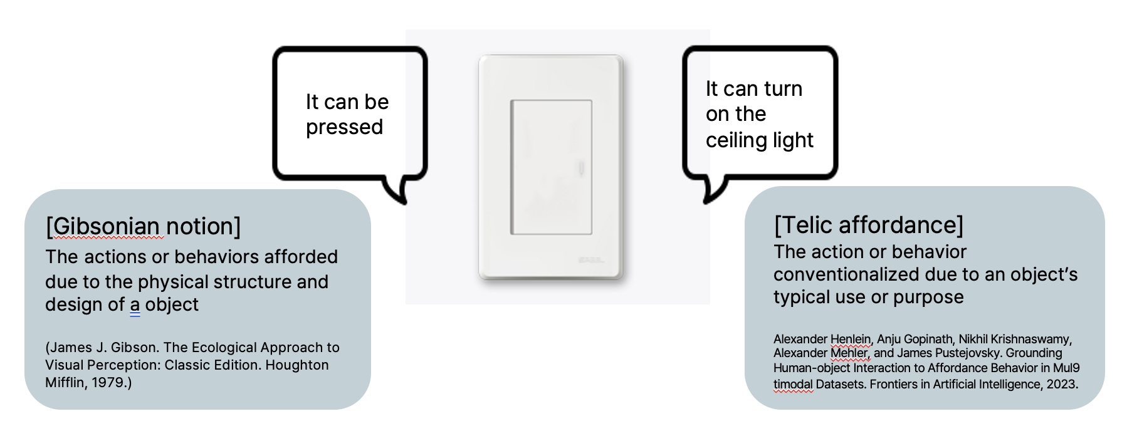
Research Plan: SceneFun3d
The way to interact with an element: Affordance

Slide 9
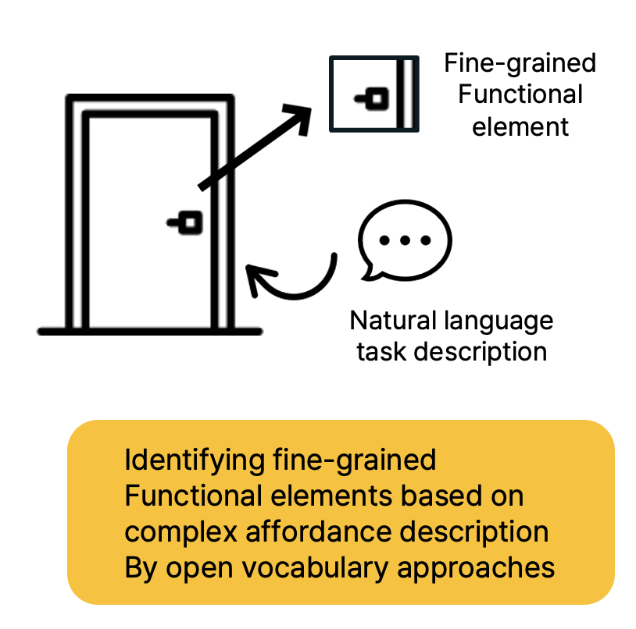
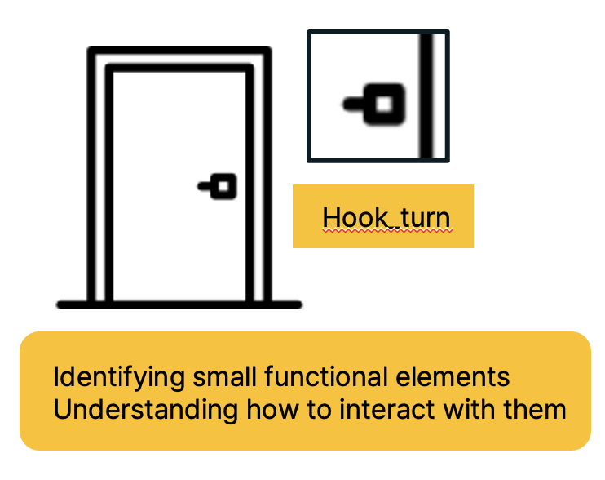
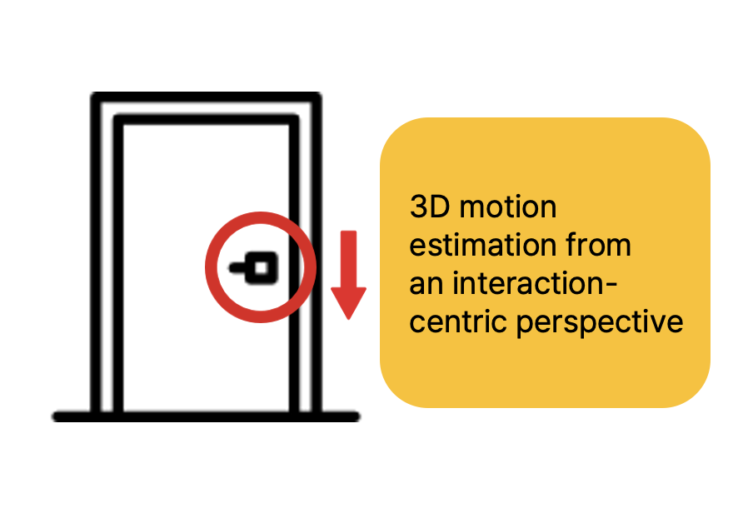
Research Plan: SceneFun3d
The way to interact with an element: Affordance

Slide 10
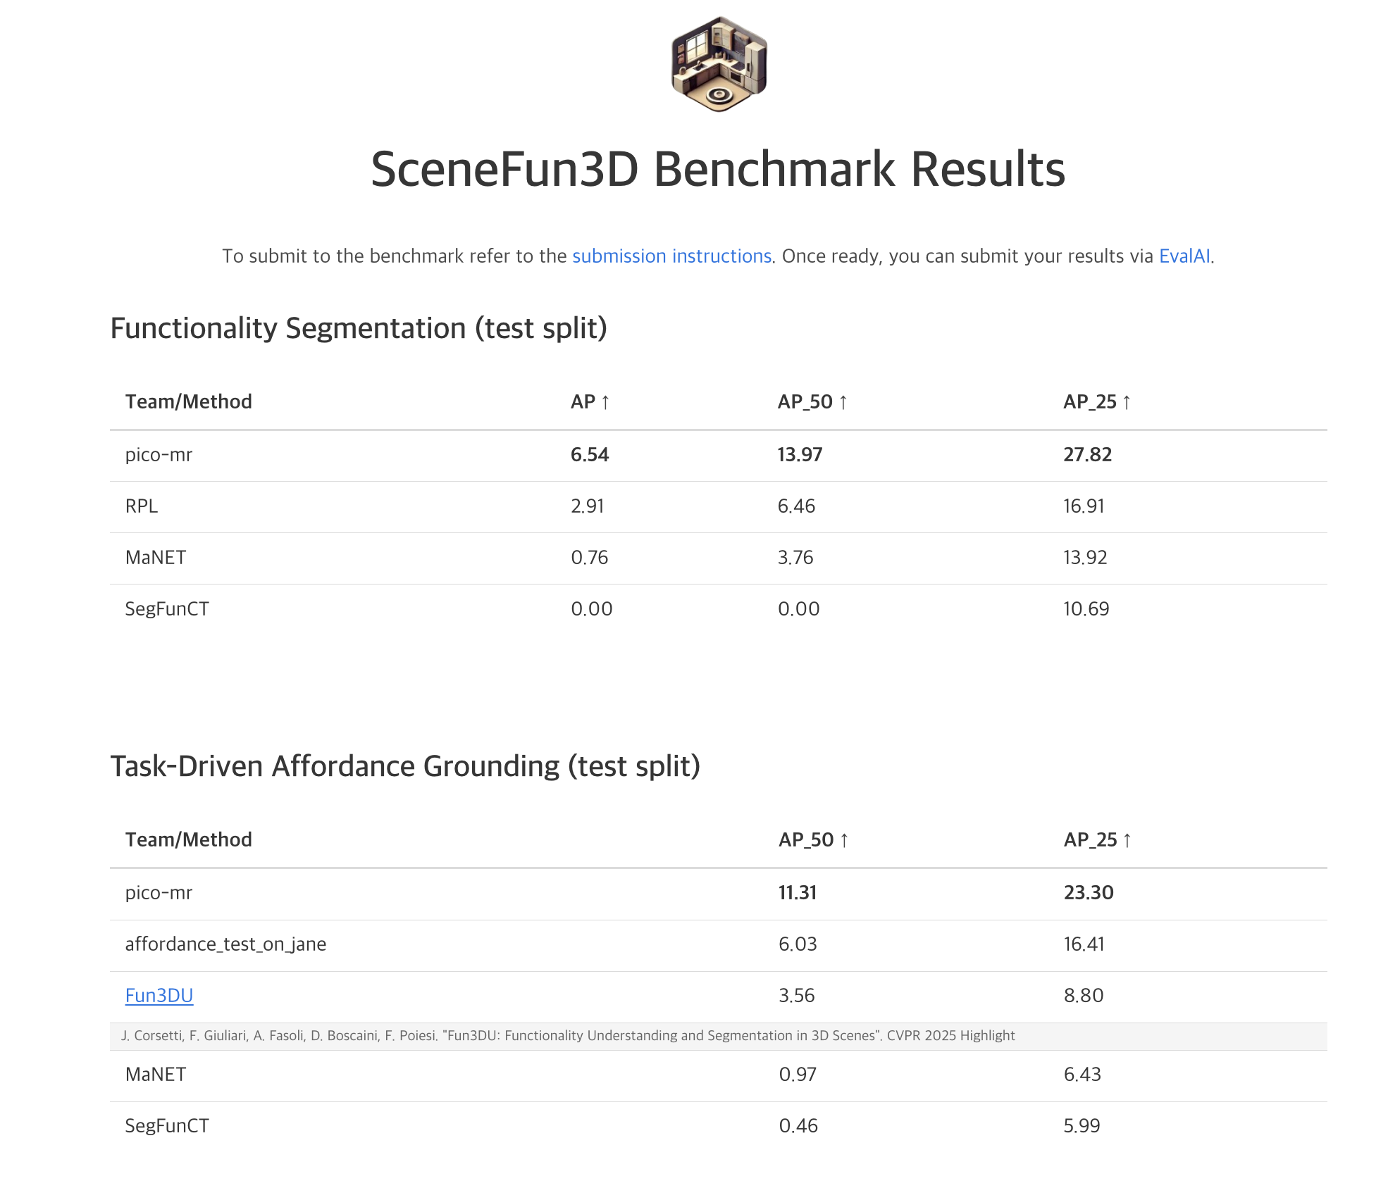
Research Plan: SceneFun3d baseline으로 score 향상

Slide 11
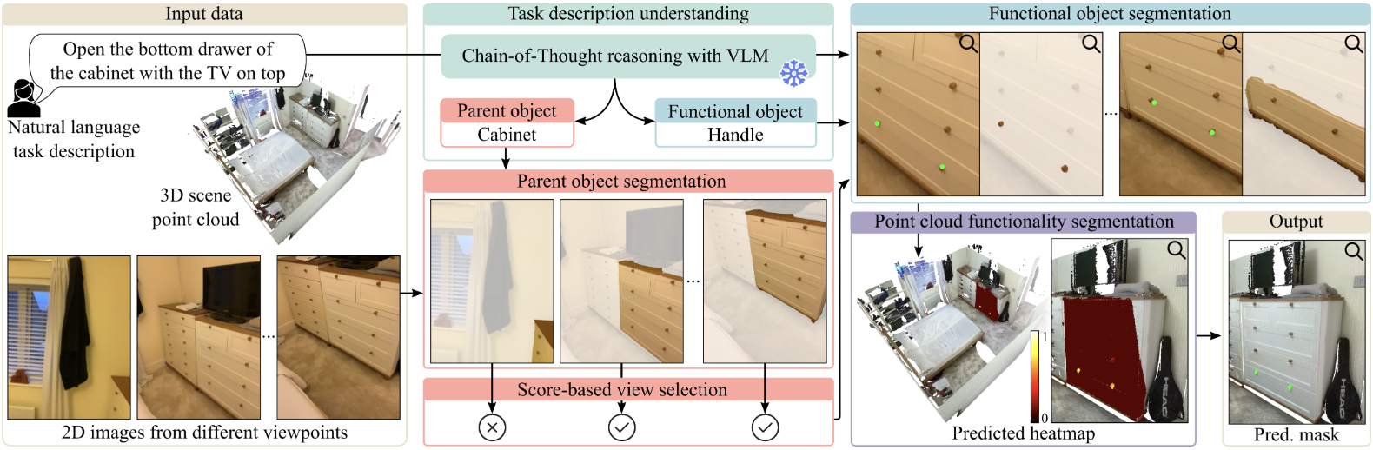
Pipeline Design
Fun3DU(CVPR 2025)
2D 이미지를 이용하여
Task 수행을 위한 object와
functional element를 찾음
만약 2D에서 잘못된 element를 찾았다면?
혹은 2D에서 object를 아예 찾지 못한다면?

Slide 12
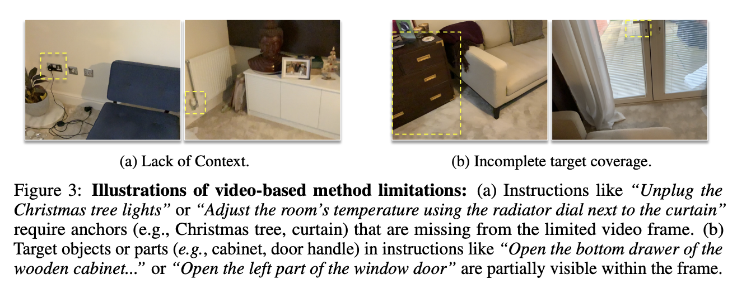
Pipeline Design
Fun3DU(CVPR 2025)
2D 이미지를 이용하여
Task 수행을 위한 object와
functional element를 찾음
AffordBot(NeurIPS 2025)
만약 2D에서 잘못된 element를 찾았다면?
혹은 2D에서 object를 아예 찾지 못한다면?

Slide 13
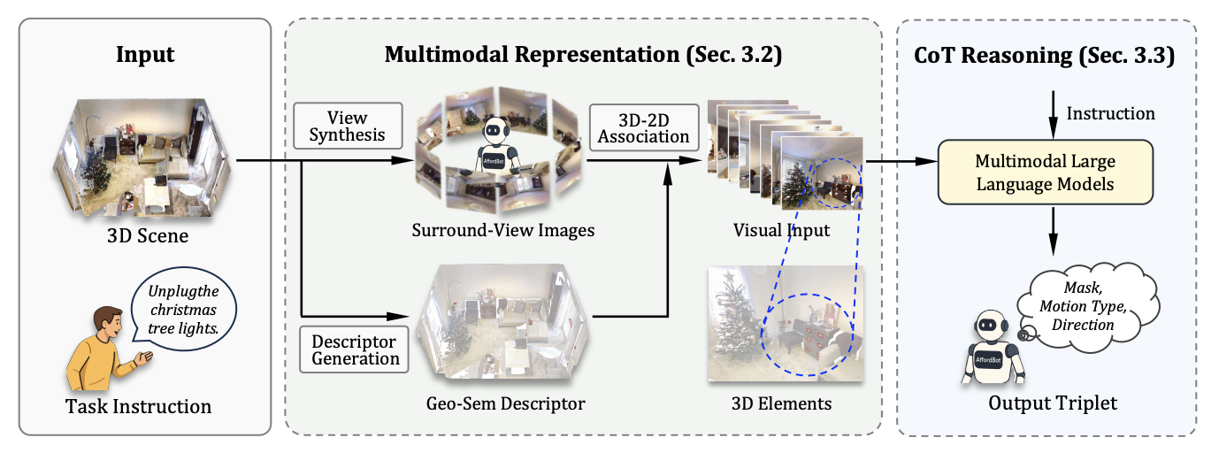
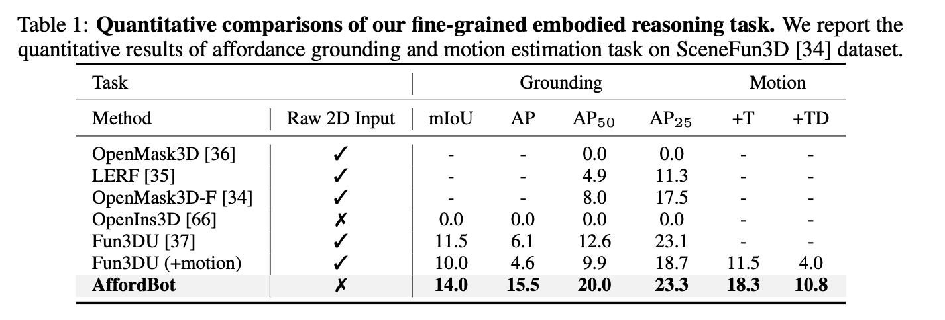
Pipeline Design
AffordBot(NeurIPS 2025)

Slide 14
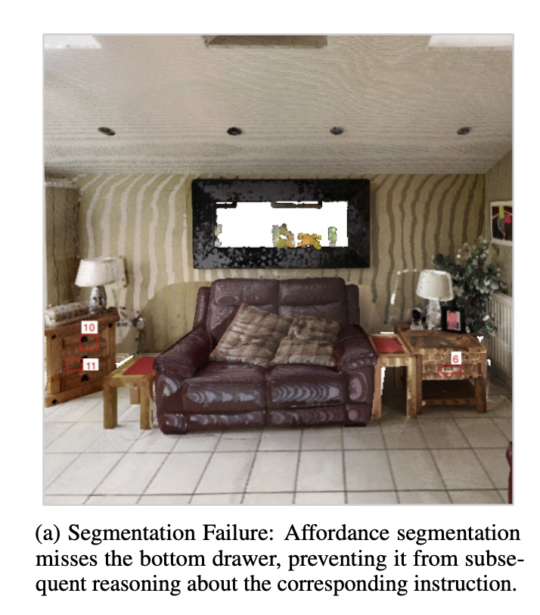
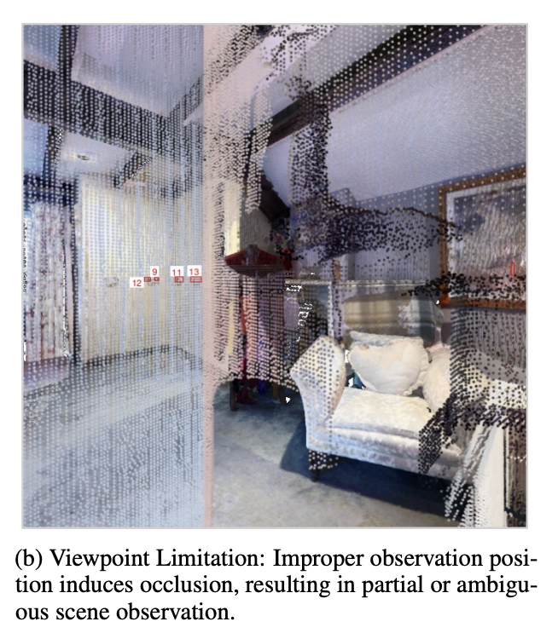
Pipeline Design
AffordBot(NeurIPS 2025)
여전히 2D view 중심 구조 => geometry precision, occlusion,
depth-dependent affordance 문제

Slide 15
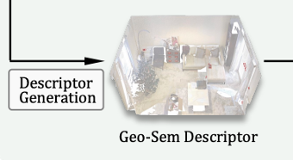
Pipeline Design
AffordBot(NeurIPS 2025)
Geo-Sem Descriptor를 MLLM 입력 형식으로
직접 매핑할 수 있다면?
Descriptor Generation: 3D scene 내 객체들의 geometric–semantic descriptor를 생성
Geo-Sem Descriptor
- geometry: shape, position, normal 등 3D 정보
- semantics: affordance label, part ID 등 의미적 정보
Mask3D를 ScanNet200 사전학습 가중치에서 시작해
SceneFun3D로 파인튜닝

Slide 16
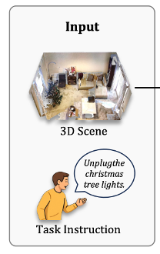
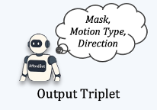

Pipeline Design
Objective
최대한 3D에서 주어지는 정보들을 보존하여
MLLM에 매핑할 수 있는 방법

Slide 17
감사합니다

